Slide 1


Fantasy Premier League
Benjamin Kelly

Slide 2
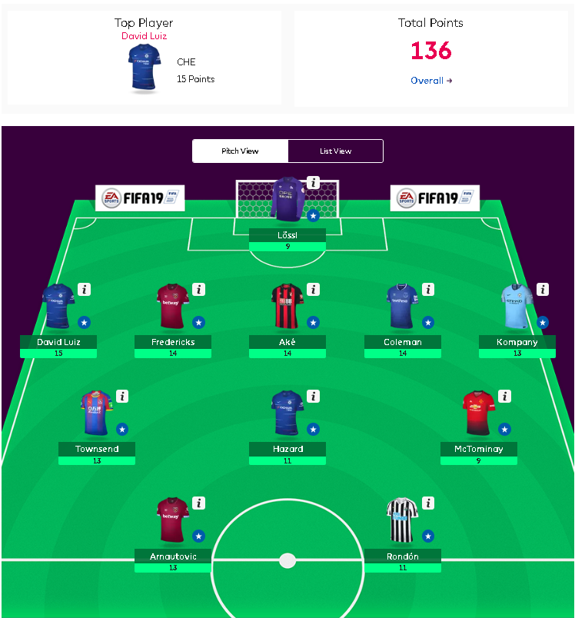
What is Fantasy Premier League?
Fantasy Premier League or more commonly called FPL is a sports game much like Fantasy Football, or Basketball
However when a user picks their team they are not picking from a draft but from all available players in the game. Users are give 100 million “dollars” to build a team they thing will have the highest point out return
Each player in the game has a different value so spending your 100 million on the right player is critical.

Slide 3
How are points scored?
In FPL players are awarded points based on performance, and position on the field.
For example if an Attacker scores a goal they are awarded 4 points, but if a Defender scores a goal they will be awarded 6 points

Slide 4
My Goals
My first goal is to use metrics from the 2017-2018 FPL help make more educated selections for future FPL teams
My second goal is to make a GUI interface that will allow users to search players based on their predicted point totals.

Slide 5

Is this project useful?
FPL websites that provide data analytical breakdowns of the game have been around for years, and have made millions of dollars in the process.
This project would also help me personal as I player FPL with friends every year.

Slide 6
FPL GUI
So, far for my project I have been able to create a Graphical User Interface that allows a user to search for a player in my dataset.

